Slide 1

react.net

Slide 2

overview
web languages
browser DOM (not important)
react (pretty important) & jsx
NB: everything is interactive
it looks like you're trying to make a winforms app

Slide 3
1. web languages
html
static content
e.g. headings, paragraphs, tables, bullet lists, etvc
javascript
dynamic content
e.g. dropdown lists, tooltips on hover, etc
css
styling
🤮

Slide 4

html
<!DOCTYPE html>
<html>
<body>
<h1>hello world</h1>
</body>
</html>

Slide 5
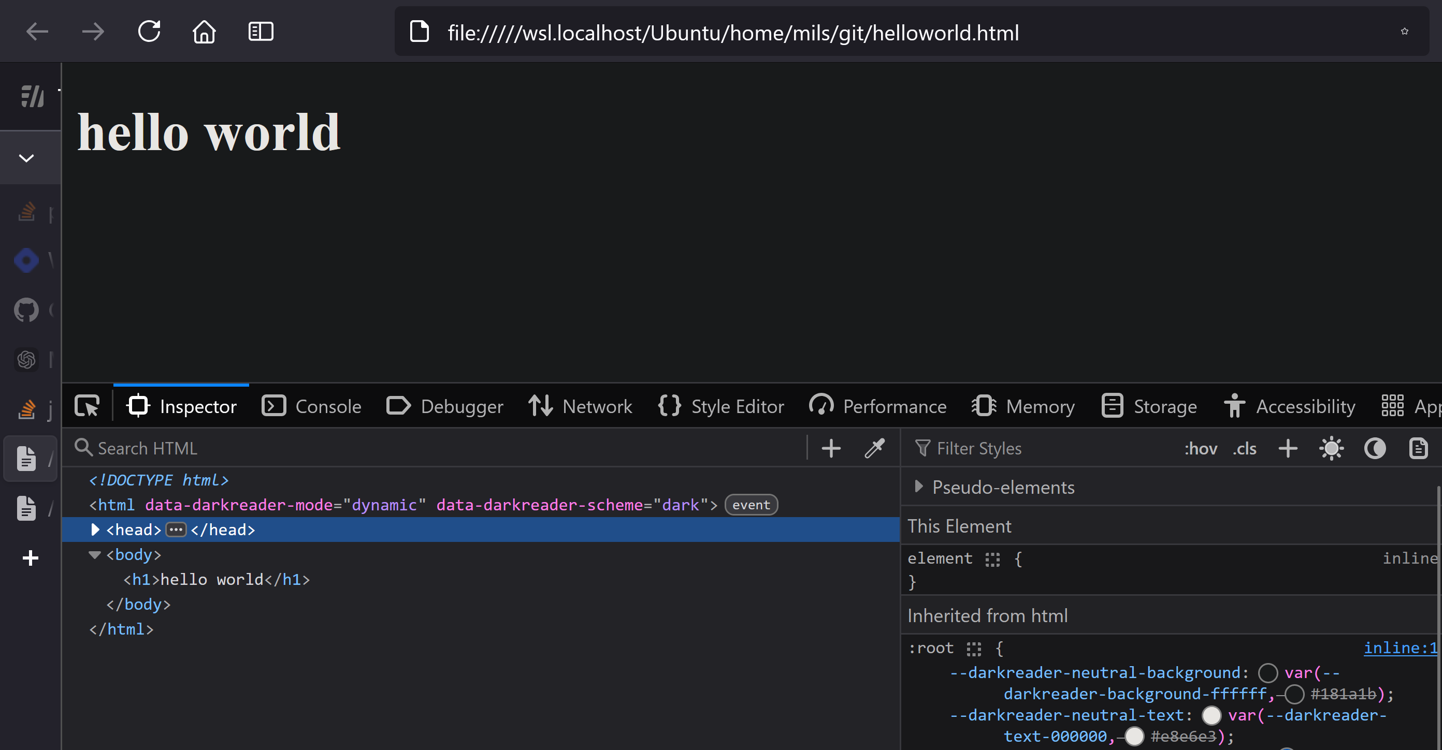
html

Slide 6
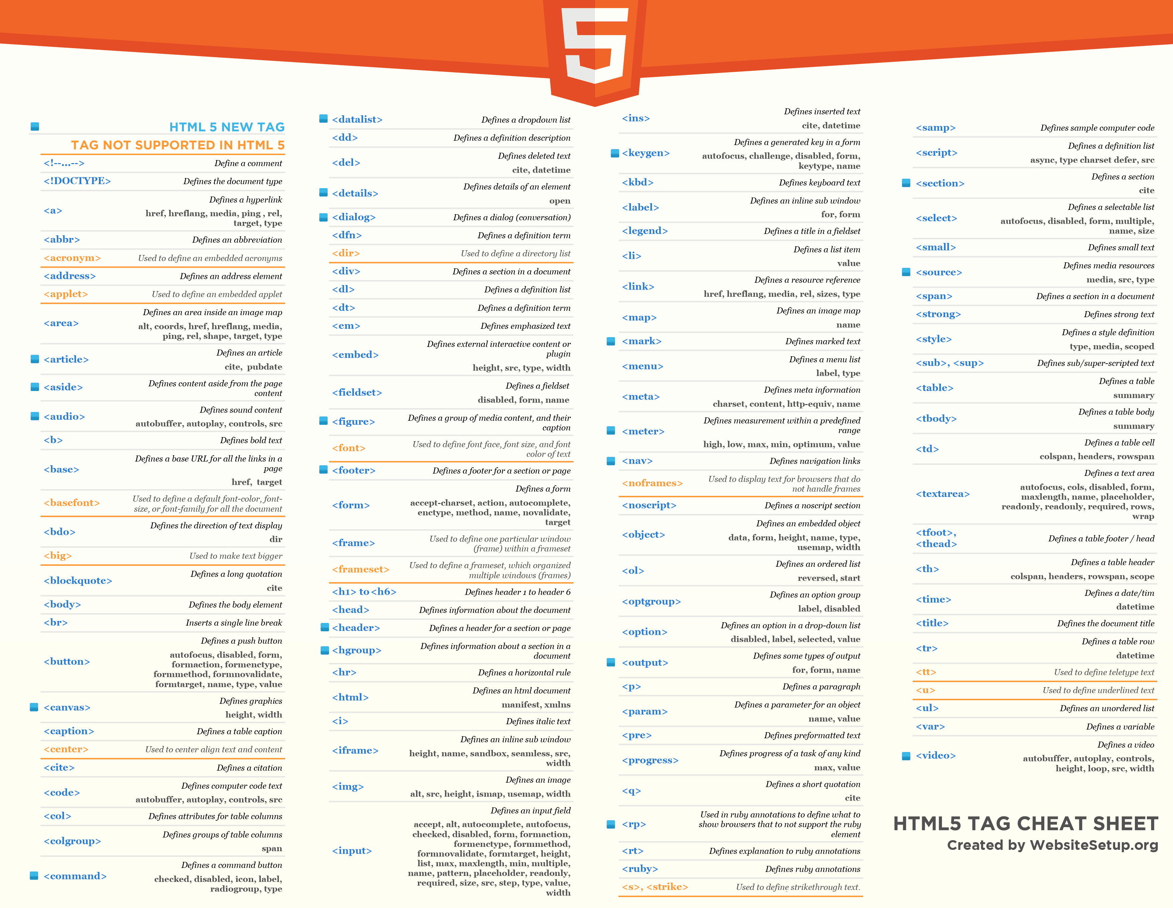

Slide 7
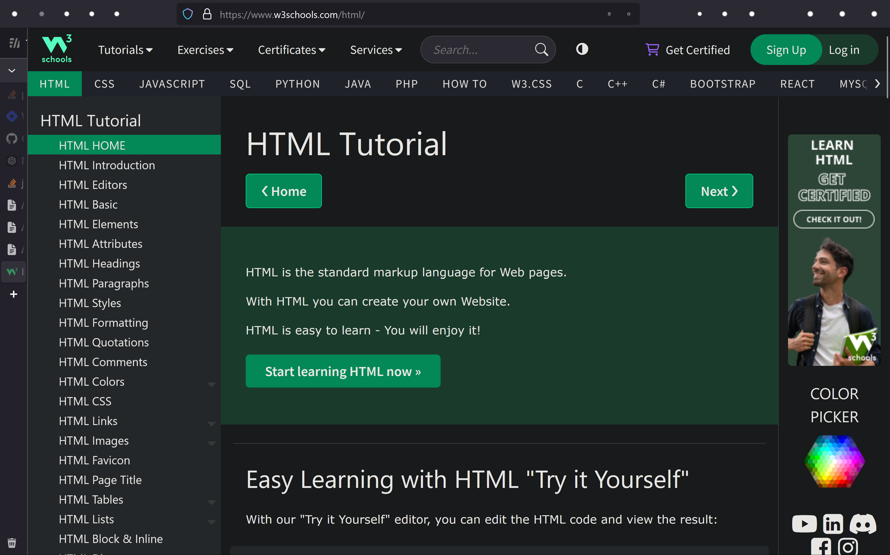

Slide 9

<!DOCTYPE html>
<html>
<body>
<h1>hello world</h1>
</body>
</html>

Slide 10
javascript
<!DOCTYPE html>
<html>
<body>
<h1 id="magic">hello world</h1>
<button
type="button"
onclick='document.getElementById("magic").innerHTML = "goodbye world!"'>
Click Me!
</button>
</body>
</html>

Slide 11
javascript
<!DOCTYPE html>
<html>
<body>
<h1 id="magic">hello world</h1>
<button
type="button"
onclick='document.getElementById("magic").innerHTML = "goodbye world!"'>
Click Me!
</button>
</body>
</html>

Slide 12
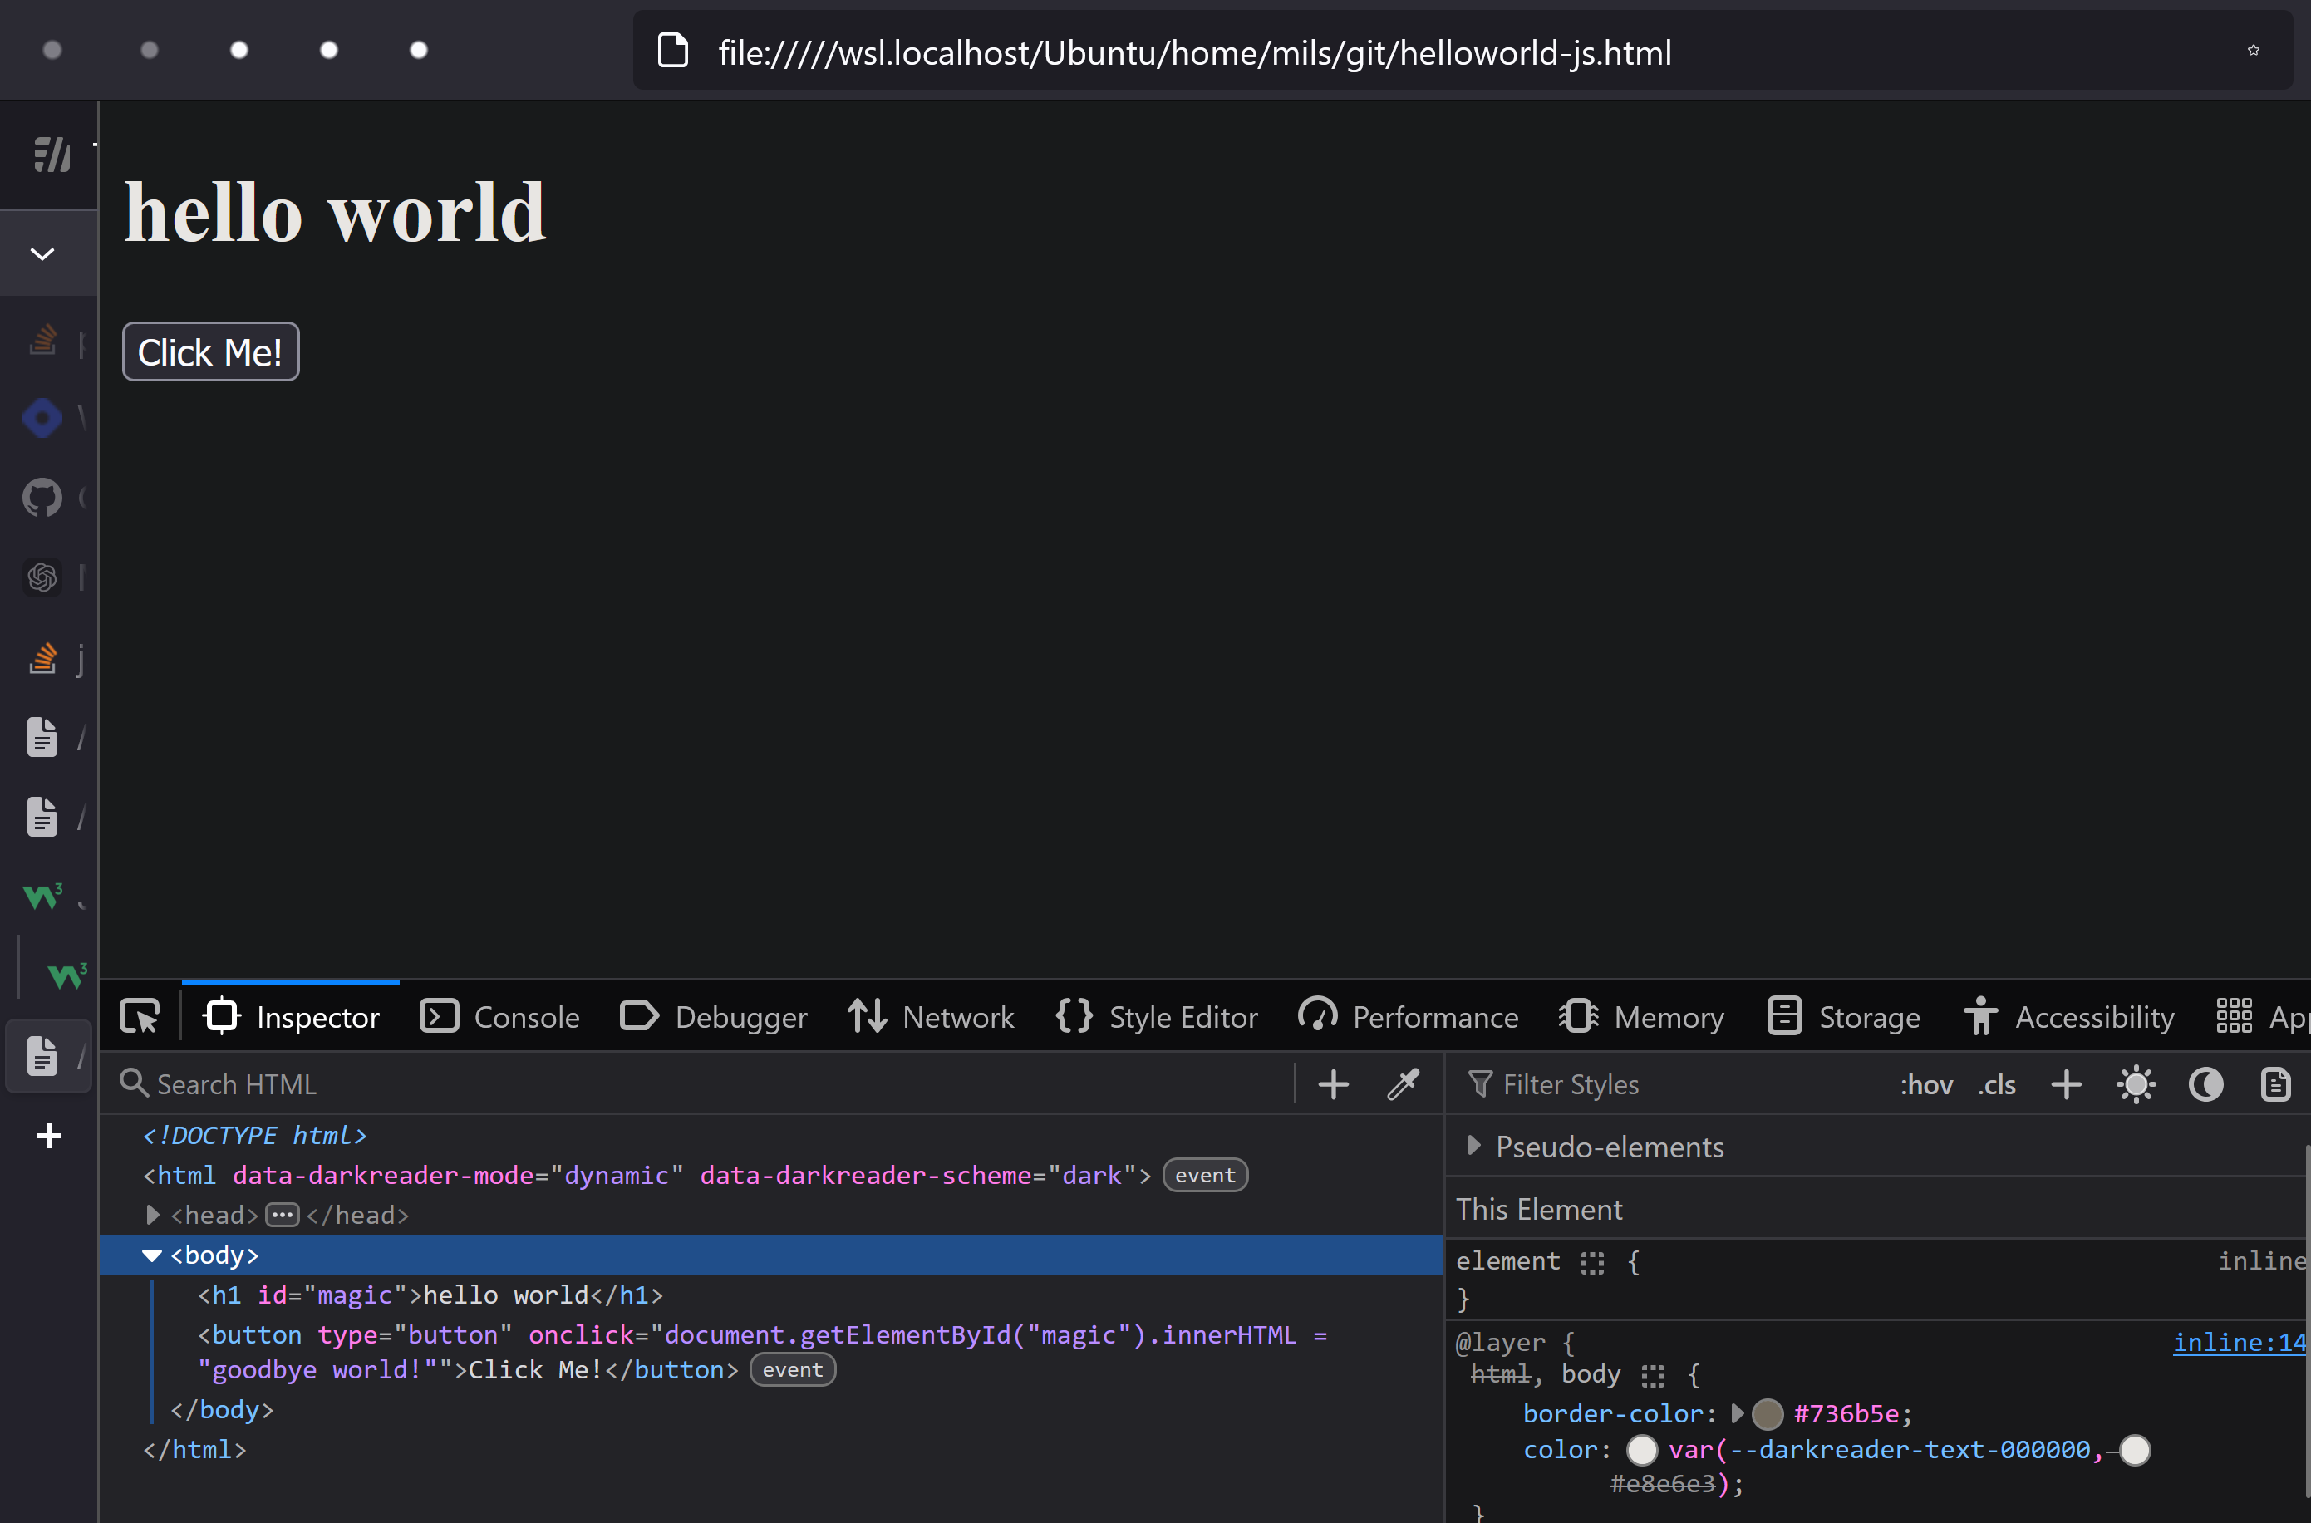
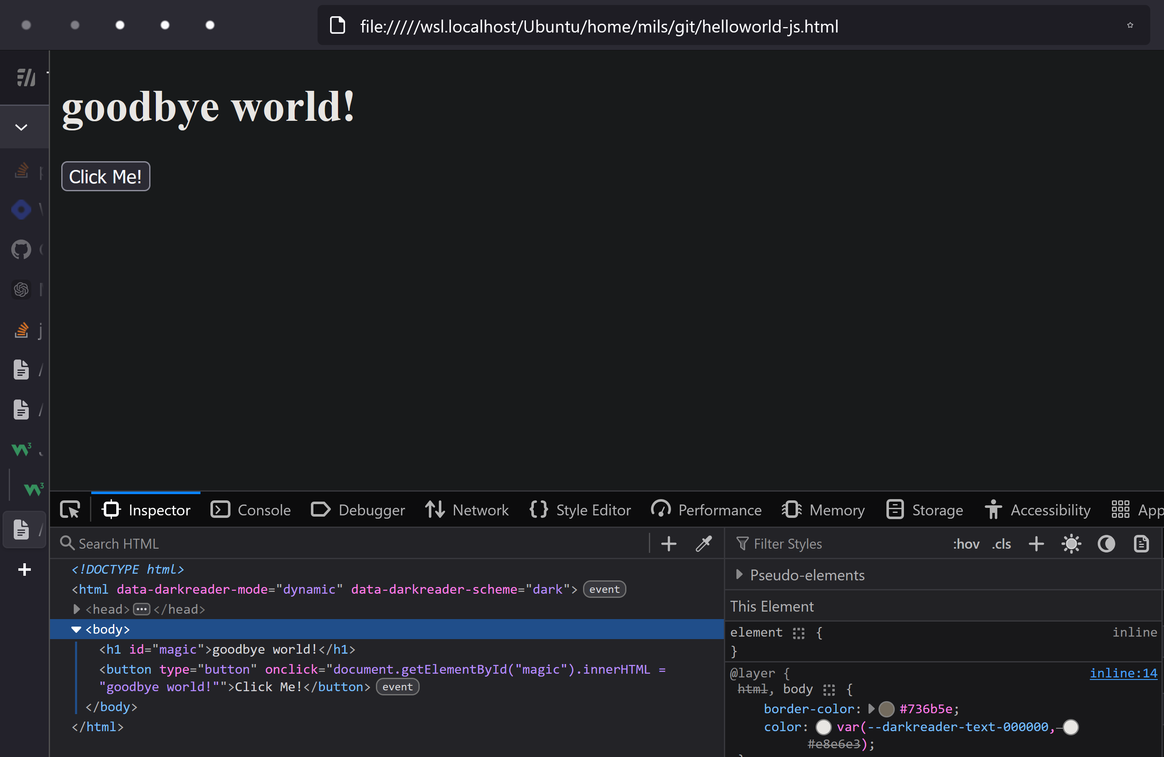
javascript

Slide 14

css

Slide 15

css

Slide 16
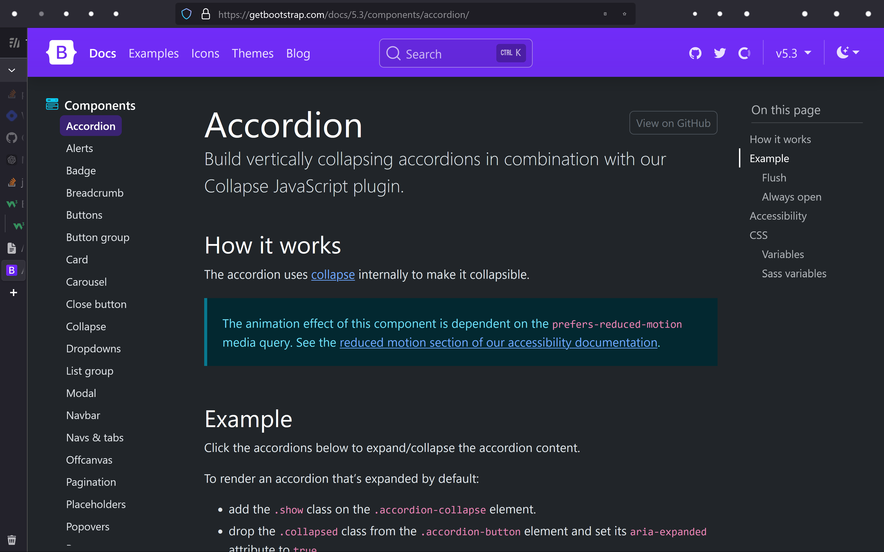

Slide 17
<!DOCTYPE html>
<html>
<body>
<h1 id="magic">hello world</h1>
<button
type="button"
onclick='document.getElementById("magic").innerHTML = "goodbye world!"'>
Click Me!
</button>
</body>
</html>

Slide 18
css
<!DOCTYPE html>
<html>
<head>
<link rel="stylesheet" href="https://maxcdn.bootstrapcdn.com/bootstrap/3.4.1/css/bootstrap.min.css">
<script src="https://ajax.googleapis.com/ajax/libs/jquery/3.7.1/jquery.min.js"></script>
<script src="https://maxcdn.bootstrapcdn.com/bootstrap/3.4.1/js/bootstrap.min.js"></script>
</head>
<body>
<h1 id="magic">hello world</h1>
<button
type="button"
class="btn btn-info"
onclick='document.getElementById("magic").innerHTML = "goodbye world!"'>
Click Me!
</button>
</body>
</html>

Slide 19
css
<!DOCTYPE html>
<html>
<head>
<link rel="stylesheet" href="https://maxcdn.bootstrapcdn.com/bootstrap/3.4.1/css/bootstrap.min.css">
<script src="https://ajax.googleapis.com/ajax/libs/jquery/3.7.1/jquery.min.js"></script>
<script src="https://maxcdn.bootstrapcdn.com/bootstrap/3.4.1/js/bootstrap.min.js"></script>
</head>
<body>
<h1 id="magic">hello world</h1>
<button
type="button"
class="btn btn-info"
onclick='document.getElementById("magic").innerHTML = "goodbye world!"'>
Click Me!
</button>
</body>
</html>

Slide 20
javascript

Slide 21
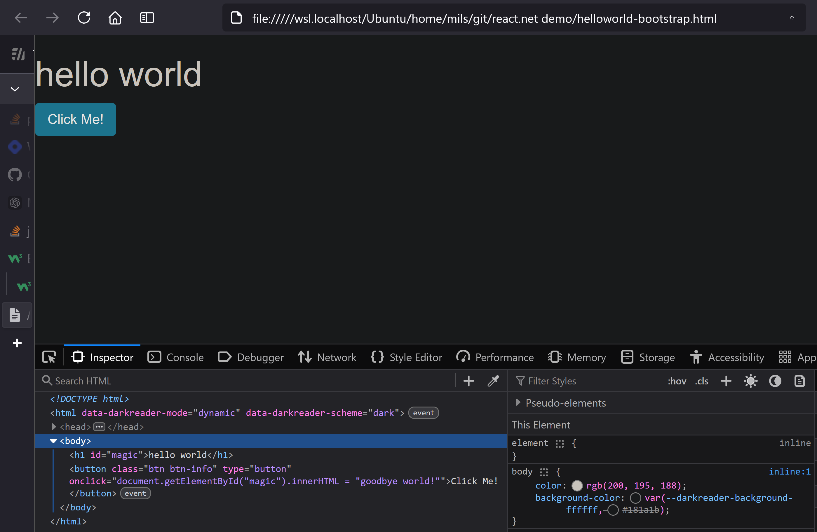

Slide 22

PHONE <select> DEMO PLACEHOLDER

Slide 23

css - the grid
the heart and soul of "responsive" apps
all libraries follow the same pattern:
base-12 grid
customize per screen side (xs, s, m, l, xl)

Slide 24
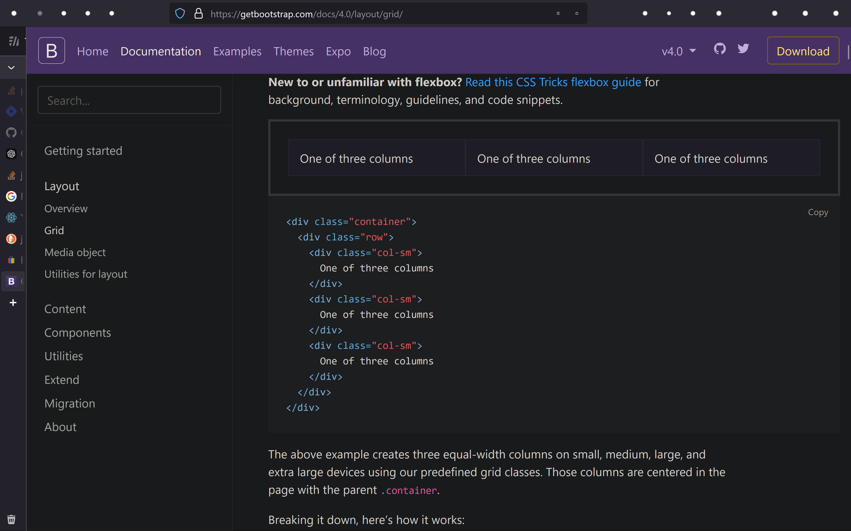
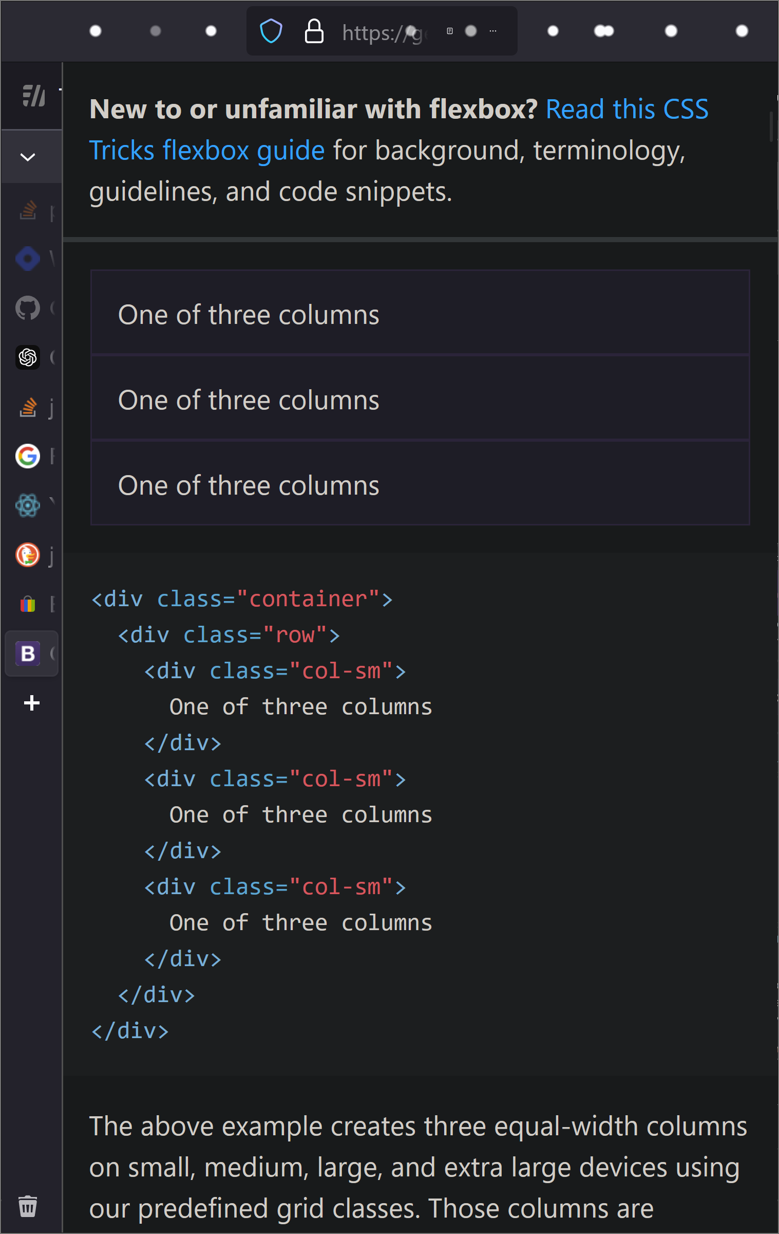
css - the grid
base 12
"for small and up, use columns.
otherwise rows"

Slide 26

DOM
"Domain Object Model"
i.e. OOP

Slide 27
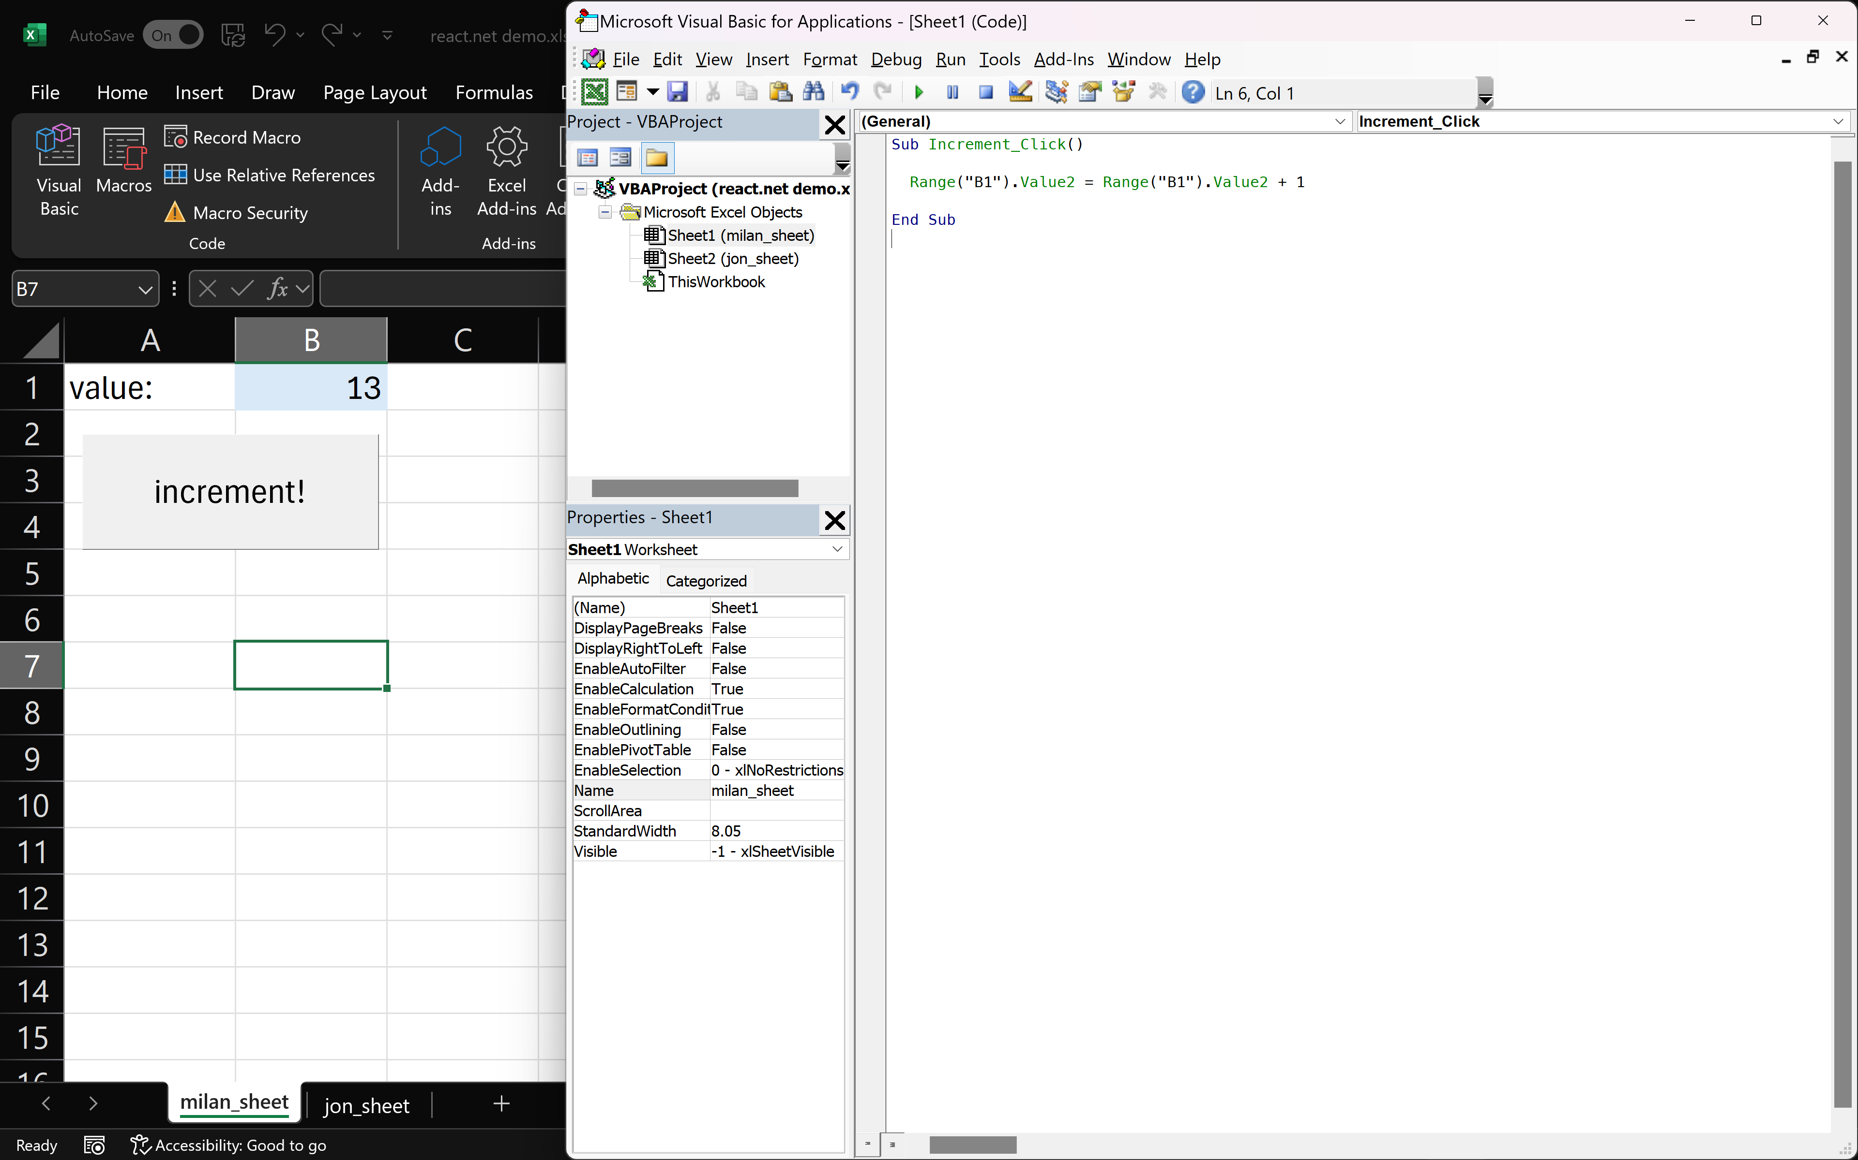
Excel DOM
Excel Domain Object Model

Slide 28
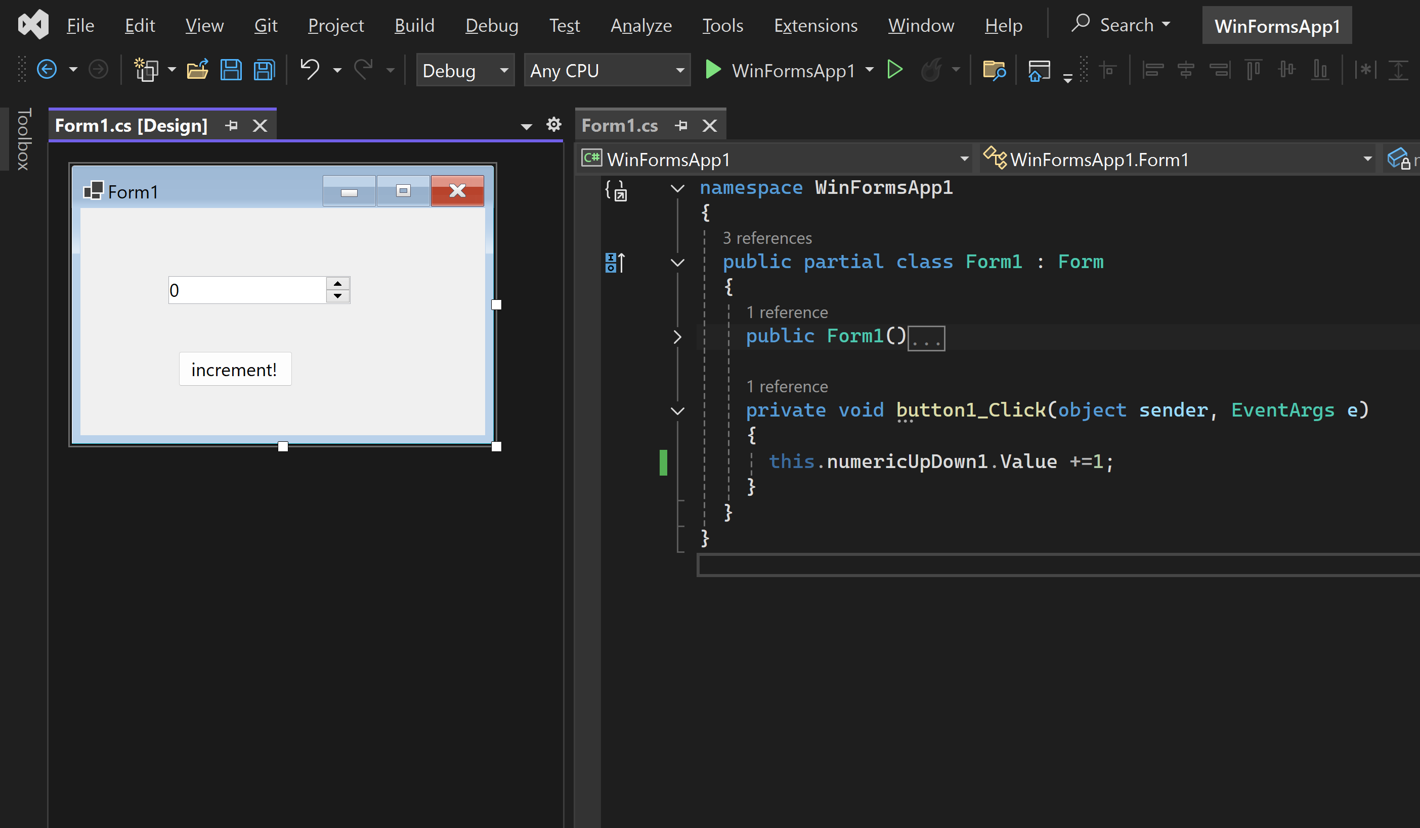
WinForms Domain Object Model

Slide 29
Browser Domain Object Model
<!DOCTYPE html>
<html>
<body>
<h1 id="magic">hello world</h1>
<button
type="button"
onclick='document.getElementById("magic").innerHTML = "goodbye world!"'>
Click Me!
</button>
</body>
</html>

Slide 30
BROWSER DOM DEMO PLACEHOLDER
(live edit, dom tree)

Slide 32

React
overview
jsx
state management
react libraries

Slide 33
React
it's just a library
entire app can be written in javascript
use javascript to write html (JSX)
far better than templating languages (jinja, etc)
bonus points:
type safety (typescript)
can be deployed as an app
state management
rendering management

Slide 34
React - MVP
<!DOCTYPE html>
<html>
<head>
<script src="https://unpkg.com/react@18.0.0/umd/react.development.js" crossorigin="anonymous"></script>
<script src="https://unpkg.com/react-dom@18.0.0/umd/react-dom.development.js" crossorigin="anonymous"></script>
</head>
<body>
<div id="root"></div>
<script>
ReactDOM.render(
React.createElement('h1', null, "Hello world"),
document.getElementById('root')
);
</script>
</body>
</html>

Slide 35
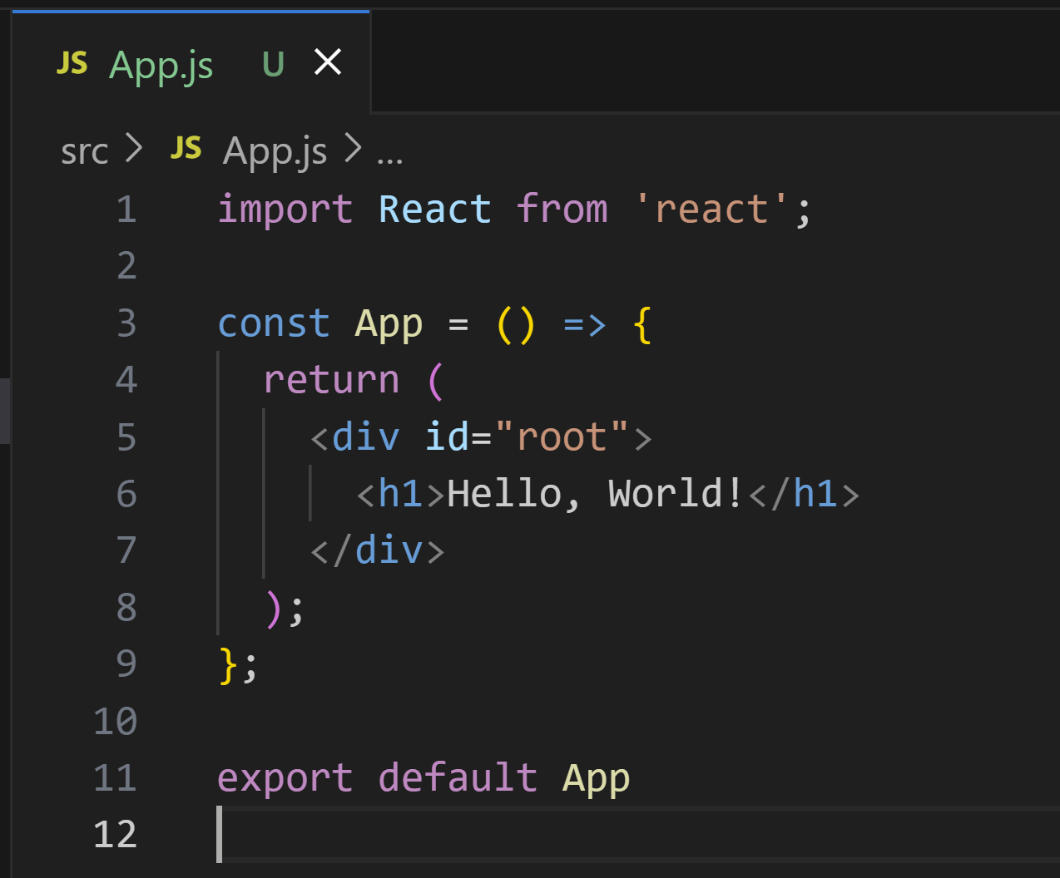


React with JSX - MVP

Slide 36
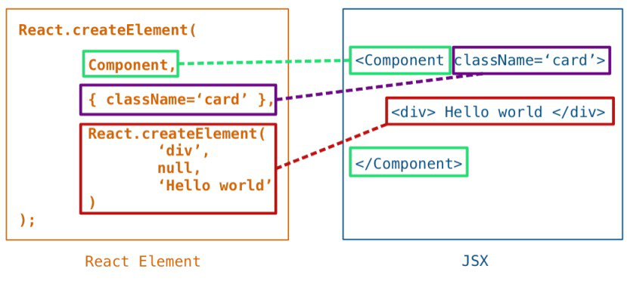
JSX

Slide 37
WinForms Domain Object Model

Slide 38
import React, { useState } from 'react';
const App = () => {
// Initialize the counter state to 0
const [counter, setCounter] = useState(0);
// Function to increment the counter
const incrementCounter = () => {
setCounter(counter + 1);
};
return (
<div>
<h1>Hello, World!</h1>
<p>{counter}</p>
<button onClick={incrementCounter}>Increment!</button>
</div>
);
};
export default App

Slide 39
State Management
useState
useEffect
contextApi
redux / zustand / etc

Slide 40
React Libraries
(redux)
styled-components
react-router
webpack
electron

Slide 41
React
tools
nvm
k6
npm & node
jest
eslint

Slide 42
References
links to client & playbook repos

Slide 43
